Slide 1

Blended Retirement System (BRS)
January 2026

Slide 2



Agenda
Retirement Planning and Financial Readiness
The Uniformed Services Blended Retirement System (BRS)
Understanding the Thrift Savings Plan (TSP)
How TSP Affects Future Retirement Savings and Military Pay
Managing Retirement Savings

Slide 3

Discussion
What do you want your life to look like at age 55?

Slide 4

Play Video
Why Save Now for Retirement?
Key Concepts:
Save now, start early
Compound earnings

Slide 5

Knowledge Check
Retirement savings grow faster when they benefit from ______ ______, because your money earns returns not only on the original contributions but also on the interest earned on those contributions.
Compound earnings

Slide 6
Discussion
What are some barriers you may face when trying to save for retirement?

Slide 7
Play Video
The Military Retirement System
Key Concepts:
Defined Benefit
Defined Contribution
Continuation Pay
Lump Sum Option

Slide 8
Knowledge Check
How long do you have to serve in order to keep the Service Automatic (1%) Contribution and its earnings?
2 Years

Slide 9
Knowledge Check
How many months after your pay entry base date (PEBD) do Service Matching Contributions begin?
25 Months from PEBD

Slide 10
Play Video
Thrift Savings Plan Basics
Key Concepts:
Overview
Contribution guidelines
Account management

Slide 11

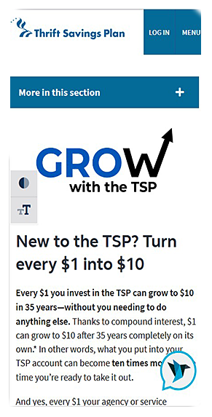





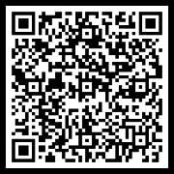
TSP Summary
Retirement savings plan
Offers Traditional and Roth accounts
Contribution guidelines:
Elections made through your pay system
Contribute from basic, incentive, special and/or bonus pays (1-100%)
Know IRS annual contribution limits
Fund selection
TSP contribution calculator
TSP Contribution Calculator

Slide 12
Knowledge Check
Where do you make changes to your TSP contribution elections?
Service payroll system

Slide 13
Knowledge Check
What is a Service member’s default contribution rate and what age-appropriate, professionally managed fund does it go into?
Default rate: 5%; Fund: Lifecycle

Slide 14
Discussion
What would motivate you to start saving today – even if retirement feels far off?

Slide 15




Savings and Pay
Start early and contribute consistently to maximize potential earnings
Compound interest
Accelerates your savings growth
Maximize Service Matching Contributions

Slide 16
Discussion
Why is it important to actively manage your TSP account, instead of simply setting it up and leaving it alone?

Slide 17

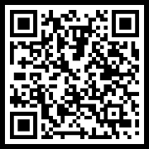
Managing Retirement Savings
Actively manage your TSP through TSP.gov or the TSP app
Your TSP account is portable
Personal financial managers/counselors
PFC Map

Slide 18
Discussion
What is one step you can take now to improve your financial security, and why act now?

Slide 19

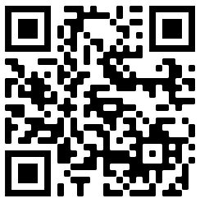
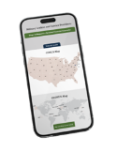


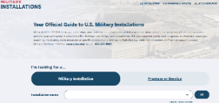






Financial Readiness Resources
Visit the FINRED website at https://finred.usalearning.gov/ for original, reliable and up-to-date financial information you can count on.
SCAN ME
Use the Personal Financial Counselor Locator Map to find:
Free financial counselors both CONUS and OCONUS
Financial literacy education, training and resources
https://finred.usalearning.gov/pfcMap
Discover MilSpouse Money Mission resources including:
Money Ready curriculum
MilLife Milestones
Videos, blogs and more
Sign up for our eNewsletter designed for Service members and spouses and service providers at:
https://finred.usalearning.gov/eNews-subscriber
MilitaryINSTALLATIONS connects you to local programs, services and resources:
https://installations.militaryonesource.mil/
Follow DoD FINRED:

Slide 20








Thank You!
Our website: https://finred.usalearning.gov/
LinkedIn: https://www.linkedin.com/company/DoDFINRED
Facebook: https://www.facebook.com/DoDFINRED
X: https://www.X.com/DoDFINRED
Instagram: https://www.instagram.com/DoDFINRED
YouTube: https://www.youtube.com/DoDFINRED
MilSpouse Money Mission: https://www.milspousemoneymission.org
Scan to visit finred.usalearning.gov

